Slide 1


MASTERCLASS Case study of the use of module 6 in a peer review [Amadora] Luís Carvalho | Civil Protection Coordinator MUNICIPALITY OF AMADORA European Forum for Disaster Risk Reduction Rome | 21ST November 2018
Notes:
1

Slide 2
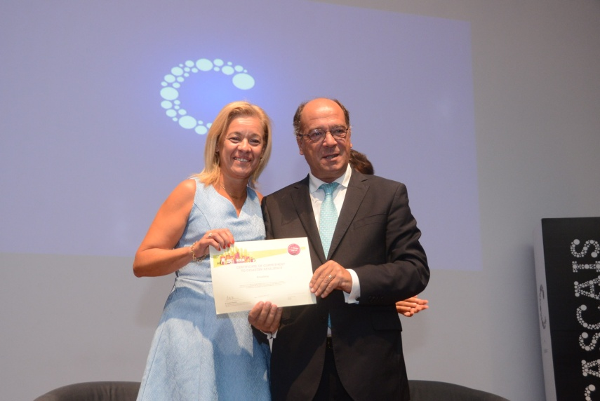
1. AMADORA USCORE2 1.1. Expected outcomes
\\ Understand our maturity in DRR: better understand if the impact of our work has real value;
\\ Identify gaps and bring a new perspective to current approaches;
\\ New ways of increasing the capacity to address risks (which may be large) in small communities (Amadora);
\\ How to empower the community groups into the political decision (DRR issues).
Notes:
2

Slide 3
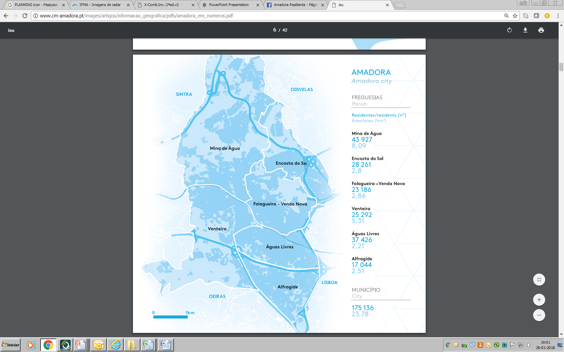
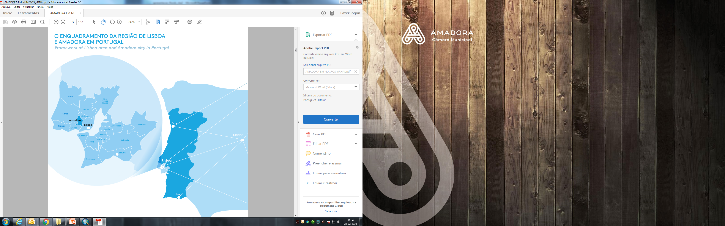
1. AMADORA USCORE2 1.1. Municipality
POPULATION
175.558
inhab.
UNEMPLOYMENT
15%
POP. DENSITY
7.363
inhab/sqkm
FOREIGN POPULATION
10%
POP. LIVING IN SLUMS
3,8%
PROPORTION OF THE ELDERLY
18,7%
Notes:
3

Slide 4
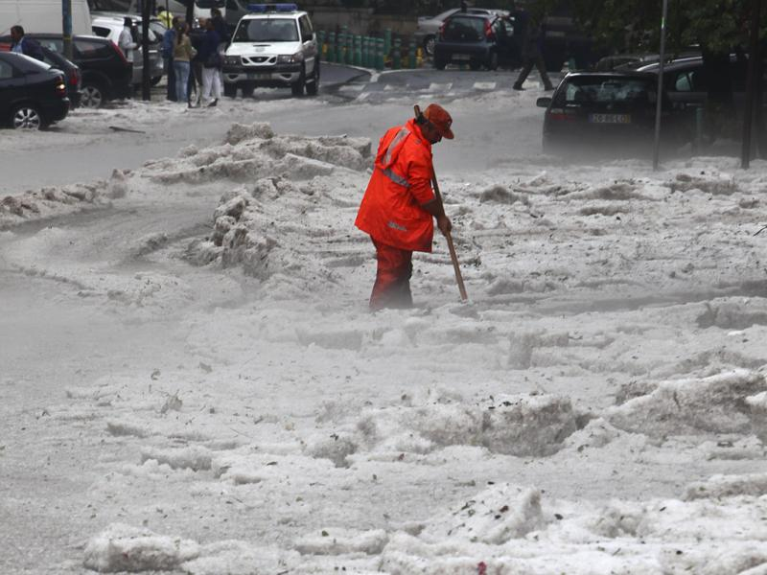
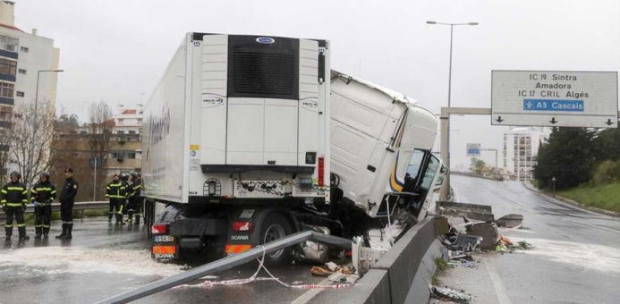
1. AMADORA USCORE2 1.3. SHOCKS AND STRESSES
SHOCKS
CATEGORY | HAZARD | IMPACT | RISK
SNOWFALL | LOW | LOW | LOW
HEATWAVE | LOW | LOW | LOW
COLDWAVE | LOW | LOW | LOW
DROUGHT | LOW | LOW | LOW
FLOODS | MEDIUM | HIGH | HIGH
EARTHQUAKE | LOW | HIGH | MEDIUM
LANDSLIDE | LOW | MEDIUM | MEDIUM
TRAFFIC ACCIDENT (ROAD) | HIGH | MEDIUM | HIGH
TRAFFIC ACCIDENT (RAIL) | MEDIUM | MEDIUM | MEDIUM
TRAFFIC ACCIDENT (AIR) | LOW | MEDIUM | MEDIUM
TRAFFIC ACCIDENT (HAZMAT) | MEDIUM | LOW | LOW
URBAN FIRE | MEDIUM | MEDIUM | HIGH
STRUCTURAL COLAPSE | LOW | LOW | LOW
FOREST FIRE | MEDIUM | MEDIUM | MEDIUM
HAZMAT | LOW | LOW | LOW
Notes:
4

Slide 5
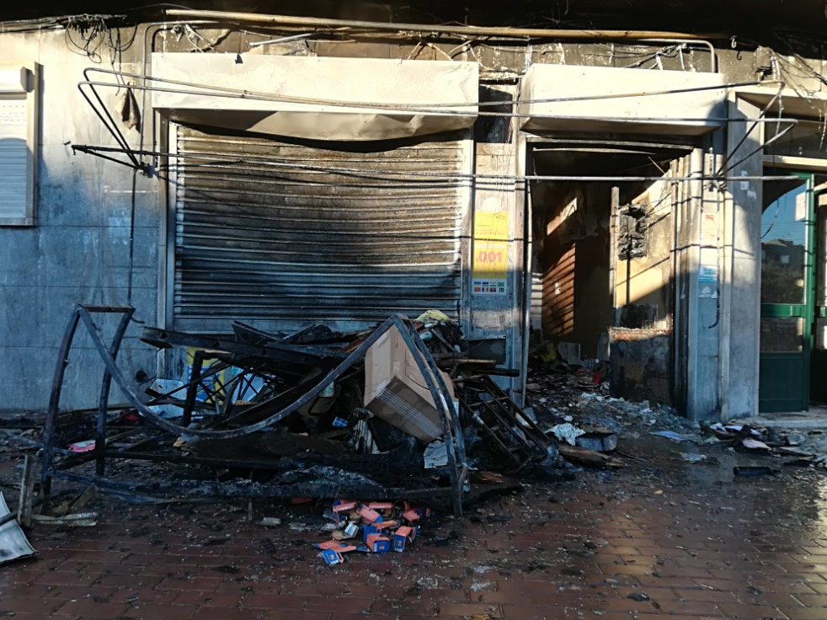
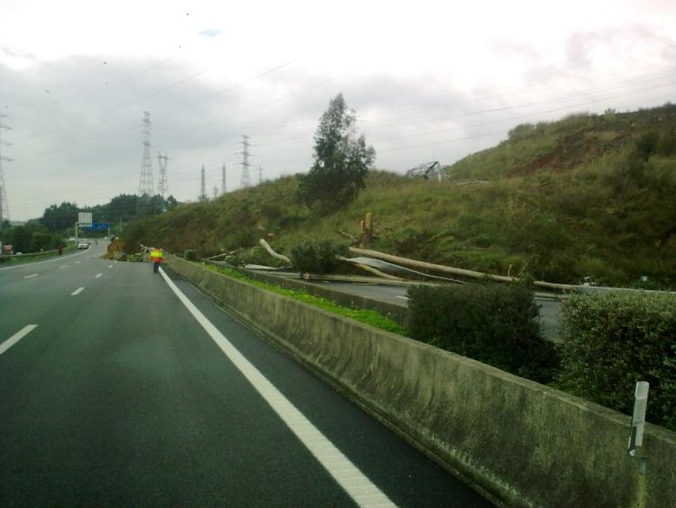
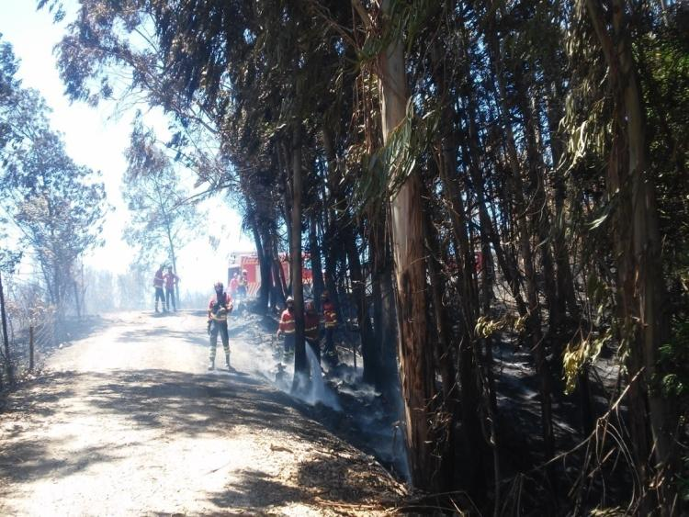
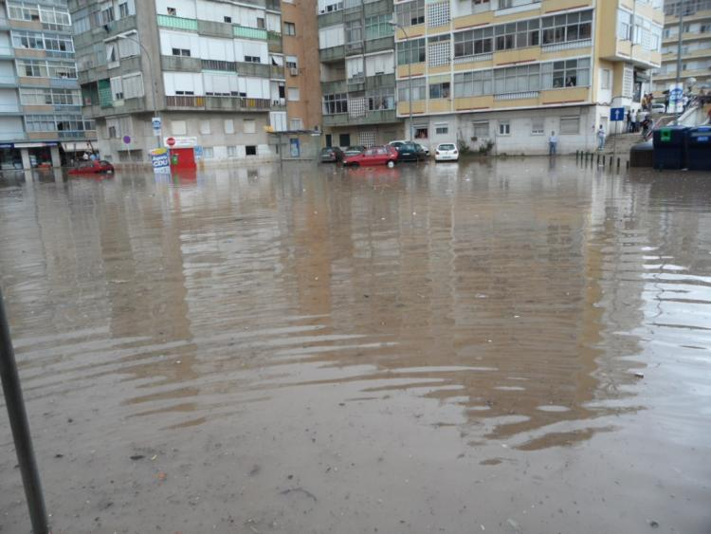
Urban fire, Amadora (2018)
Landslide, Amadora (2010)
5
Forest fire, Amadora (2016)
Flash flood, Amadora (2011)

Slide 6
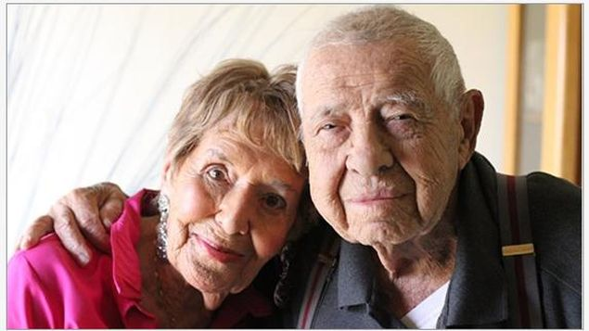
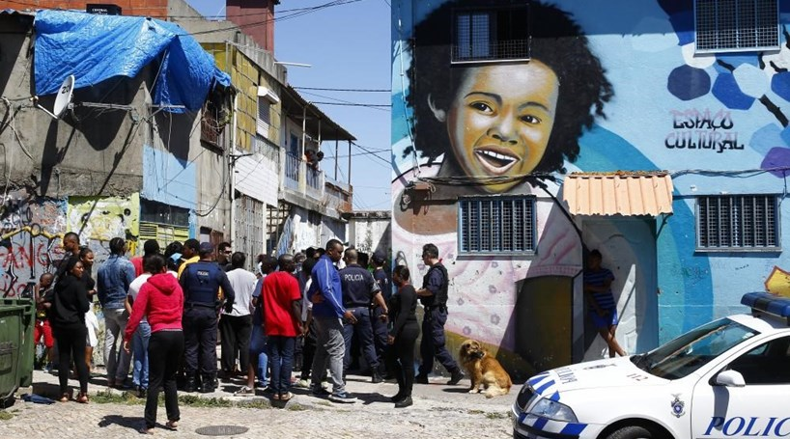
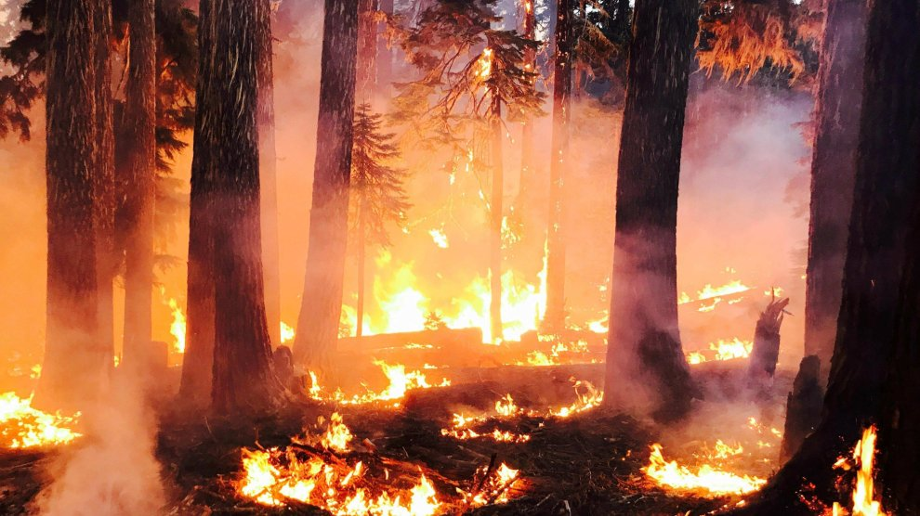
1. AMADORA USCORE2 1.3. SHOCKS AND STRESSES
STRESSES
Notes:
6

Slide 7
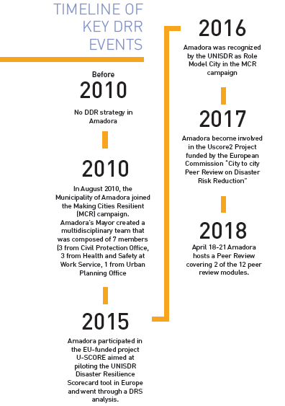


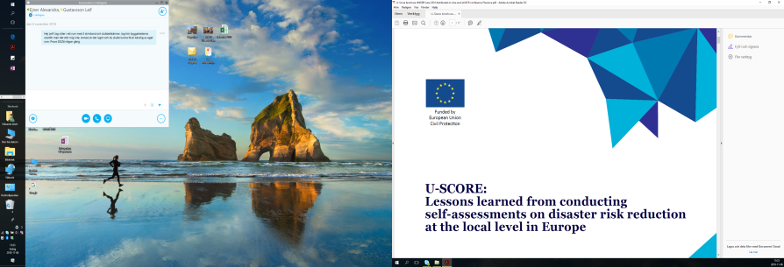
1. AMADORA USCORE2 1.3. Key DRR Events
Notes:
7

Slide 8
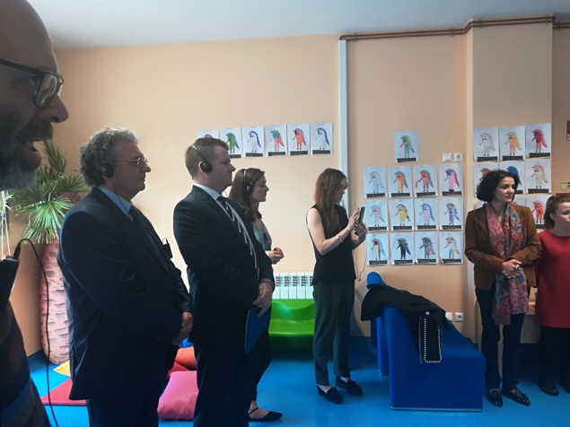
2. PEER REVIEW AMADORA 2.1. Team and Modules
Country - City | Name | Role
IT - Viggiano | Giuseppe Guarino | General Director, Gruppo Lucano
IT - Viggiano | Giuseppe Priore | City Council Member, Viggiano – President, Gruppo Lucano
IT - Viggiano | Luciano Garramone | Senior Researcher, Italian Space Agency
UK – Great Manchester | Kathy Oldham | Chief Resilience Officer, Greater Manchester
UK – Great Manchester | Jon Percival | Project Manager, Uscore2
UK – University of Manchester | Jennifer Bealt | University Of Manchester
MODULES AMADORA
M1 | DISASTER RISK GOVERNANCE
M6 | STRENGTHEN INSTITUTIONAL CAPACITY FOR RESILIENCE
Notes:
8

Slide 9
2. PEER REVIEW AMADORA 2.2. Modules
USCORE2 PEER REVIEW MODULE | MAKING CITIES RESILIENT 10 ESSENTIALS
6. Strengthen institutional capacity for resilience | Essential Six: Strengthen institutional capacity for resilience
\\ improve networking from the point of view of institutional resilience;
\\ better understand the importance of local government in supporting the construction of a culture of security;
\\improve efficiency and effectiveness of risk communication to entities and the population;
\\better understand what is lacking in order to have a local platform on resilience, with the contribution of local stakeholders.
WHY?
Notes:
9

Slide 10
2. PEER REVIEW AMADORA 2.3. Module 6
USCORE2 PEER REVIEW MODULE
6. Strengthen institutional capacity for resilience
\\ several papers published also in collaboration with universities;
\\ reports on expert exchanges with other European cities; extensive information on awareness, training and education programs.
\\ a site visit to the José Garcês Primary School.
\\ interviews with several stakeholders including representatives of volunteering associations.
METHODOLOGY
Subject / Issue | Question / Assessment Area
Skills and Experience | Does the city have clear access to all the skills and experience it believes it would need to reduce risks and respond to identified disaster scenarios?
Public education and awareness | Does a co-ordinated public relations and education campaign exist, with structured messaging and channels to ensure hazard, risk and disaster information (that can be understood and used) is properly disseminated to the public?
Data sharing | Extent to which data on the city’s resilience context is shared with other organisations involved with the city’s resilience.
Training delivery | Are there training courses covering risk and resilience issues offered to all sectors of the city including government, business, NGOs and the community?
Languages | Are training materials available in the majority of languages in common use in the city?
Learning from others | Is the city proactively seeking to exchange knowledge and learn from other cities facing similar challenges?
Notes:
10

Slide 11
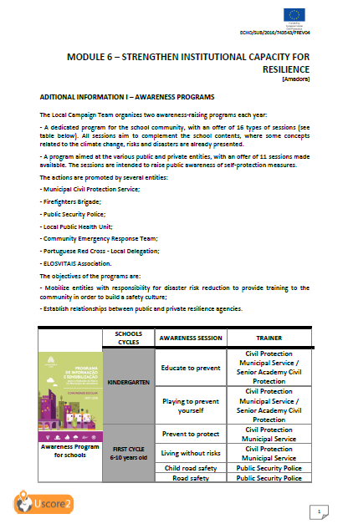


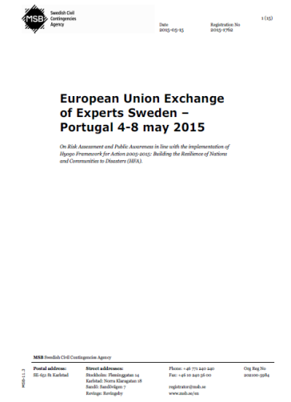
2. PEER REVIEW AMADORA 2.3. Module 6
The information provided by the host city (Amadora) was a big challenge: delivery with criteria and quality!!!
PRE-VISIT INFORMATION
Notes:
11

Slide 12
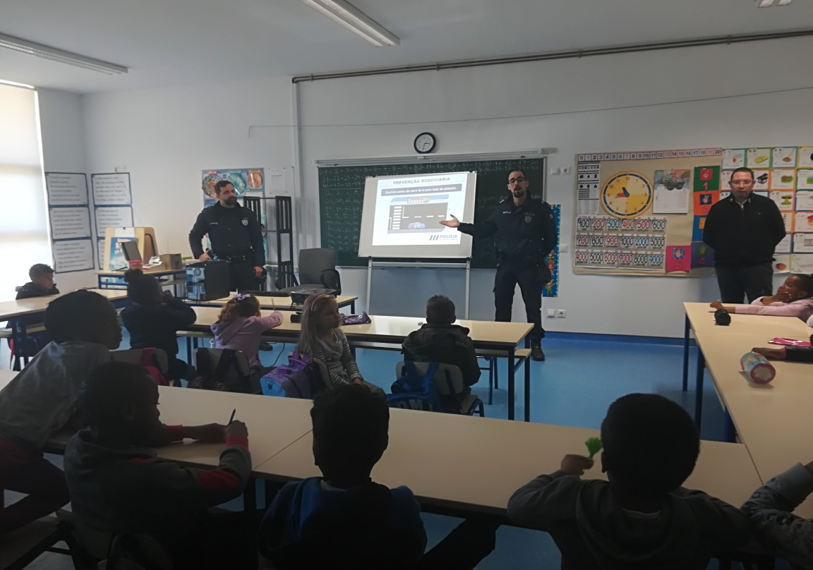
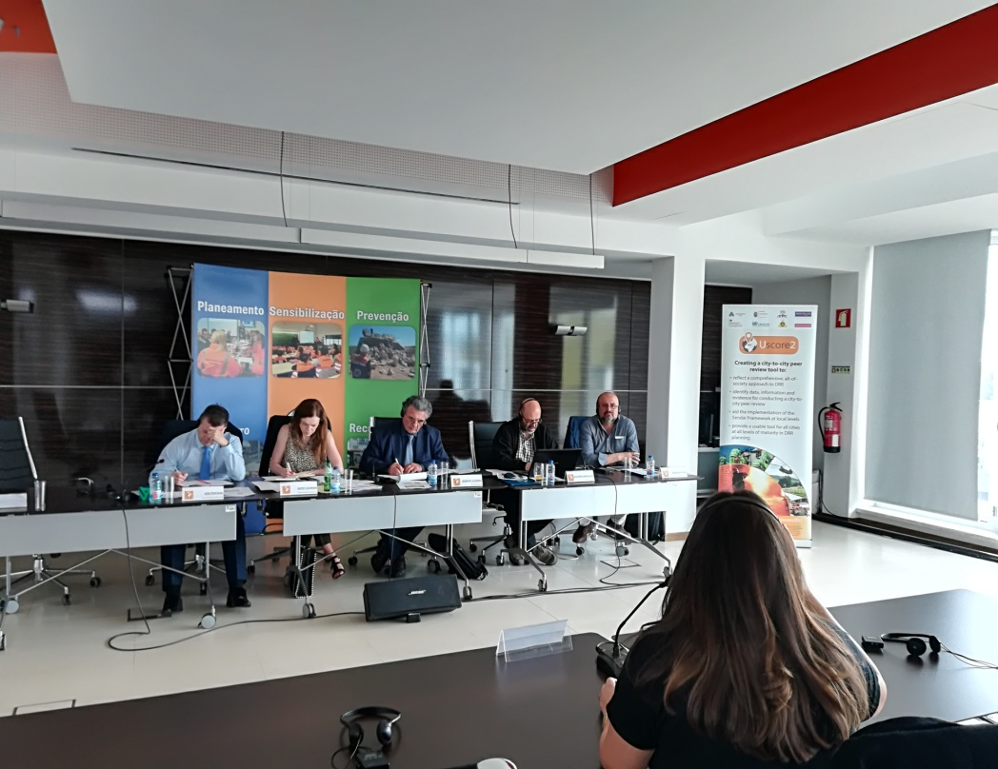
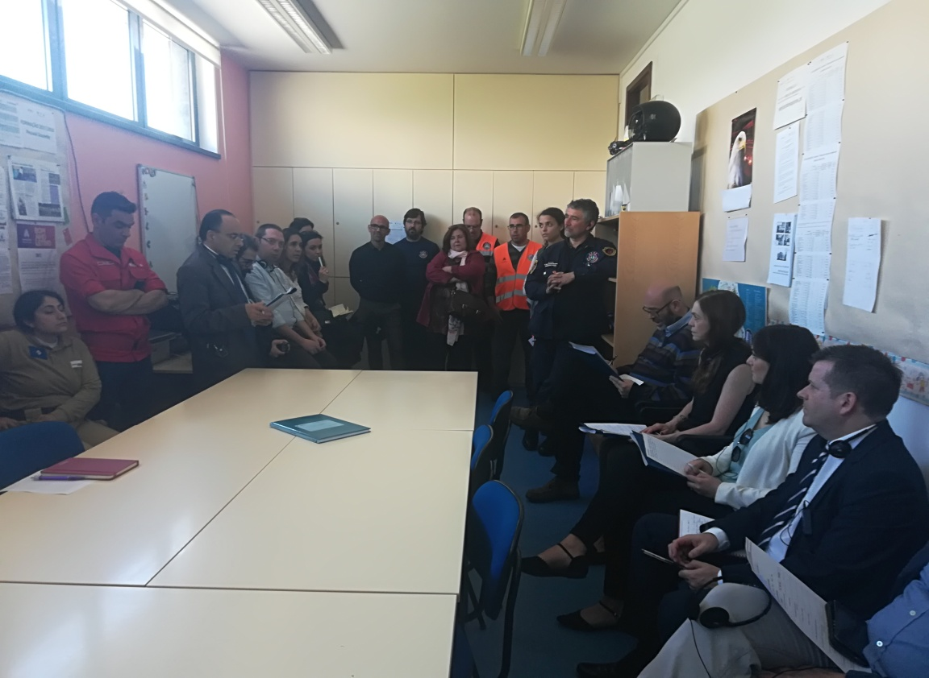
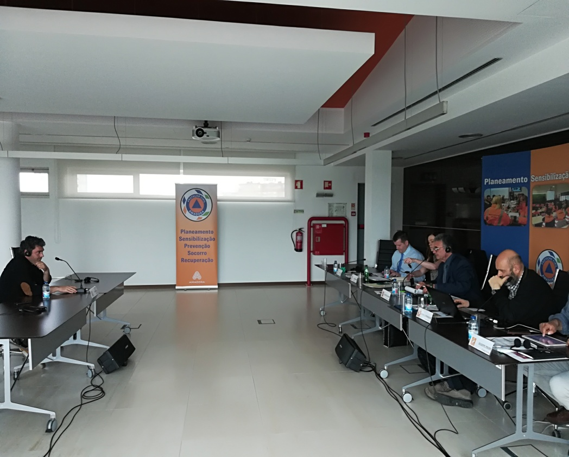
SITE VISIT : Primary School
INTERVIEWS: 12 stakeholders

Slide 13
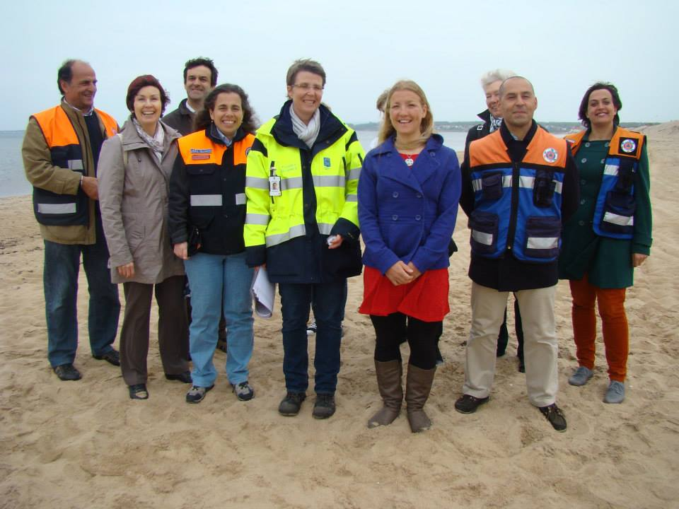
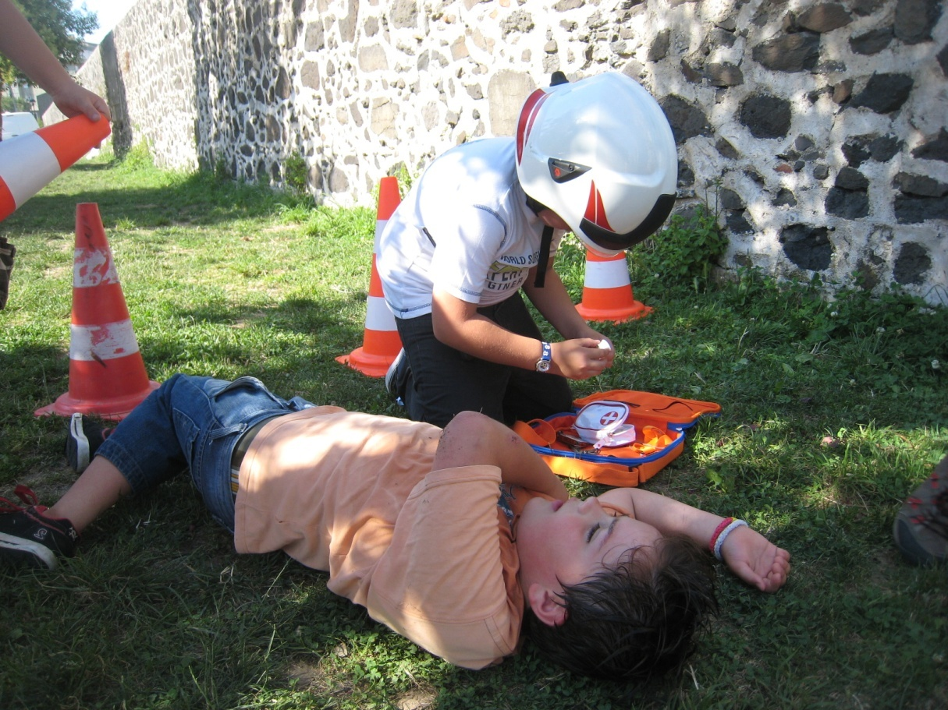
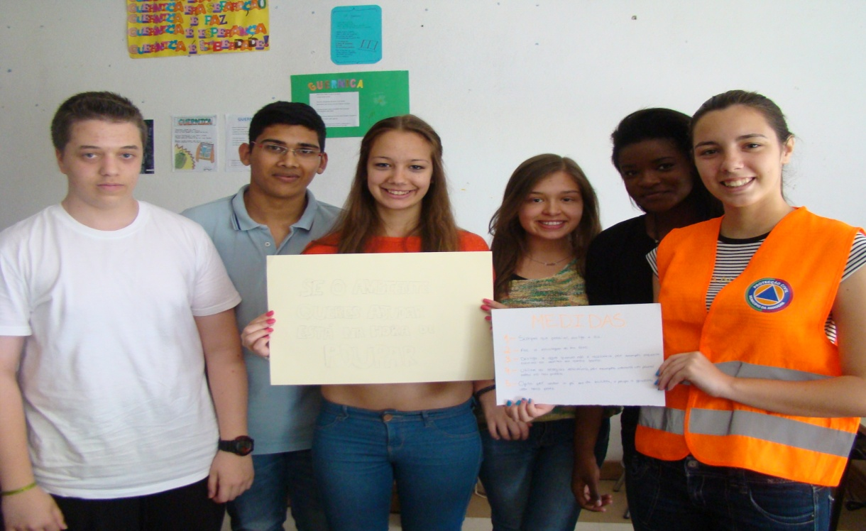
2. PEER REVIEW AMADORA 2.3. Module 6
FIND EVIDENCES: IDENTIFIED GOOD PRACTICE
\\ Amadora has developed an impressive and co-ordinated public relations and education campaign especially focused on children and older people.
\\ Political leadership of the Mayor and of the city council.
\\ Amadora is actively pursuing open data sharing among relevant stakeholders.
\\ Continuing relationships with other cities, in particular at the international level.
Notes:
13

Slide 14
2. PEER REVIEW AMADORA 2.3. Module 6
FIND EVIDENCES: IDENTIFIED AREAS TO CONSIDER STRENGTHENING
\\ The process of data sharing is not structured.
\\ Extend the scenarios for drills to risks in training offers.
\\ The city could consider holding a multi-agency exercise for one or more of the city’s reasonable worst case disaster scenarios .
\\ The city should build strong links between the road safety advice and accident prevention work of the police and the experience of firefighters in responding to road traffic accidents.
\\ Less evidence of the involvement of the NGO’s in the process of response to emergencies
\\ Awareness materials in different languages.
\\ Several stakeholders highlighted the importance of psychological support during the response to emergencies.
Notes:
14

Slide 15
2. PEER REVIEW AMADORA 2.3. Module 6
RECOMENDATIONS
\\ Full validation of the emergency plan through specific sets of drills and exercises.
\\ Amadora may consider formally launching a local platform for disaster risk reduction and a programme of work in line with the global commitments in the Sendai Framework.
\\ The city should promote the existing work developed within the education and training campaign for children and older people as good practice with other cities in the Making Cities Resilient Campaign.
\\ The city should strengthen the education and prevention campaign on risks to reach all parts of the population
Notes:
15

Slide 16
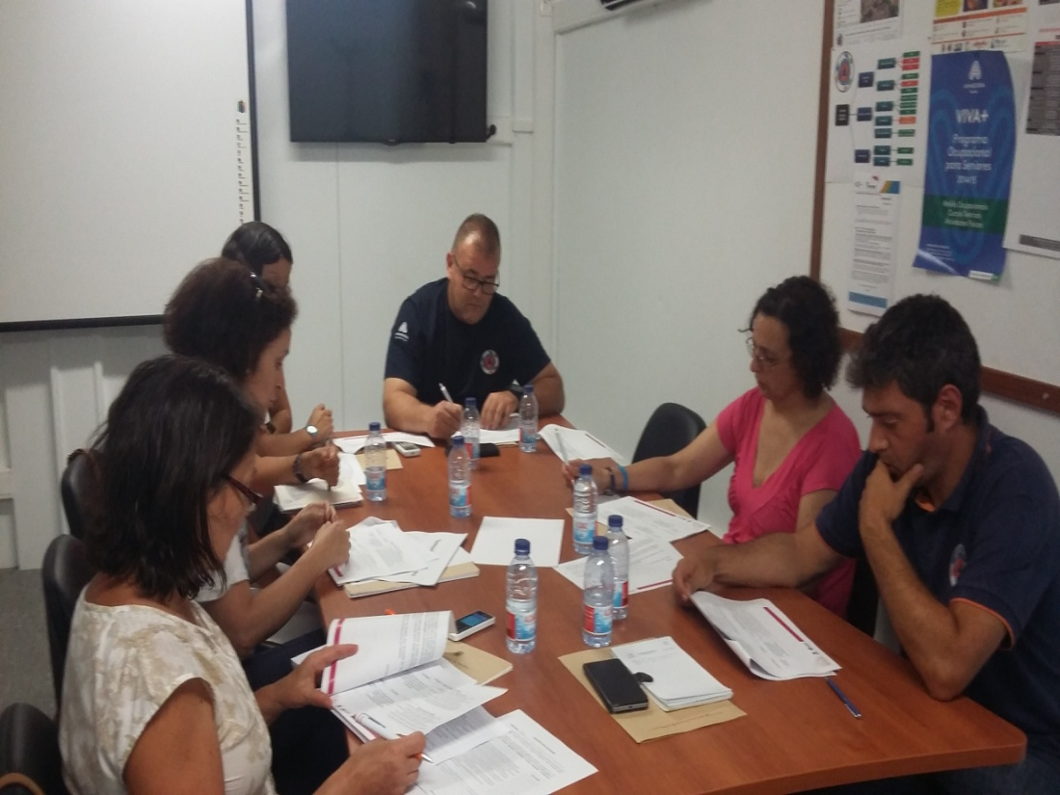
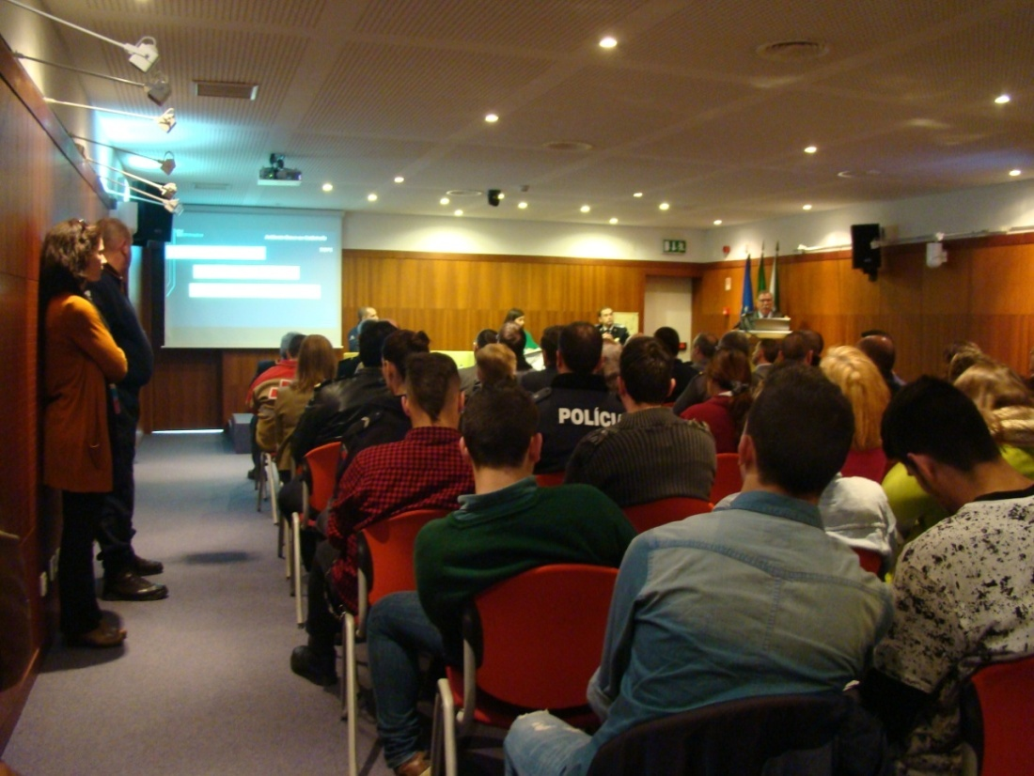
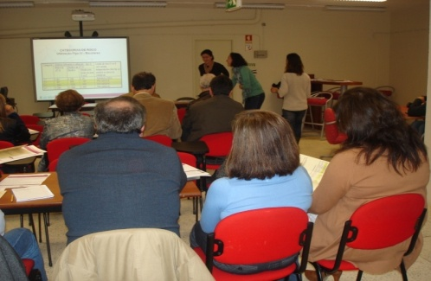
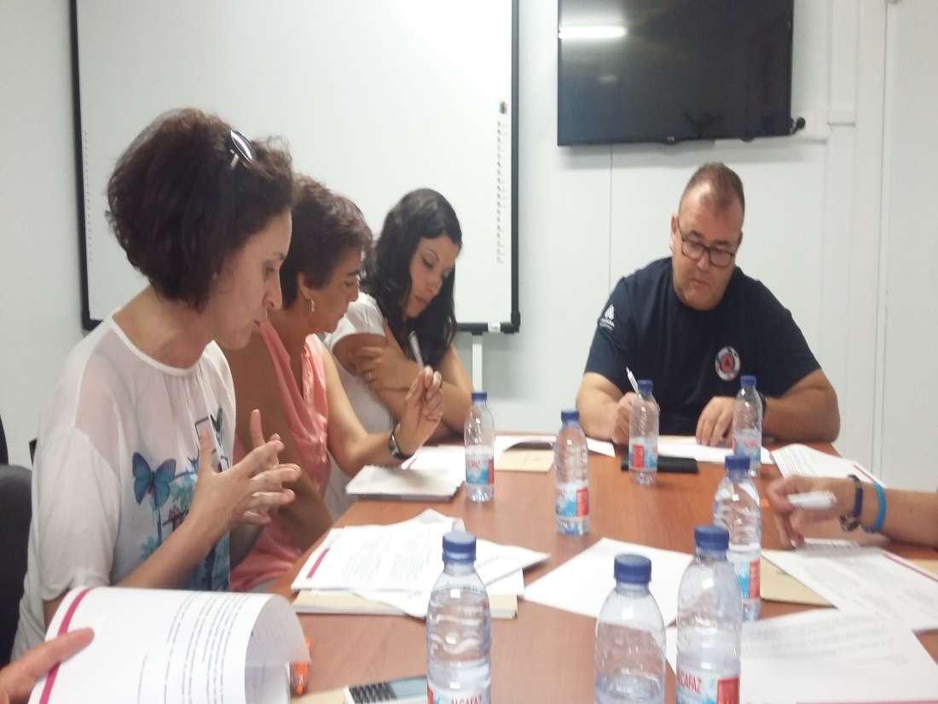
DISCUSSION ON THE PEER REVIEW RECOMMENTATIONS

Slide 17
2. PEER REVIEW AMADORA 2.4. Benefits\impacts
REFLECTION
vs
ACTION
1. PRESENTATION TO THE STAKEHOLDERS THE AMADORA PEER REVIEW
2. DISCUSS THE AREAS TO STRENGTHENING AND RECOMMENDATIONS
3. ACTION PLAN
RESILIENCE STRATEGY
We didn´t have time to implment all the recommendations\outcomes of the USCORE1 project!!!
Notes:
17

Slide 18
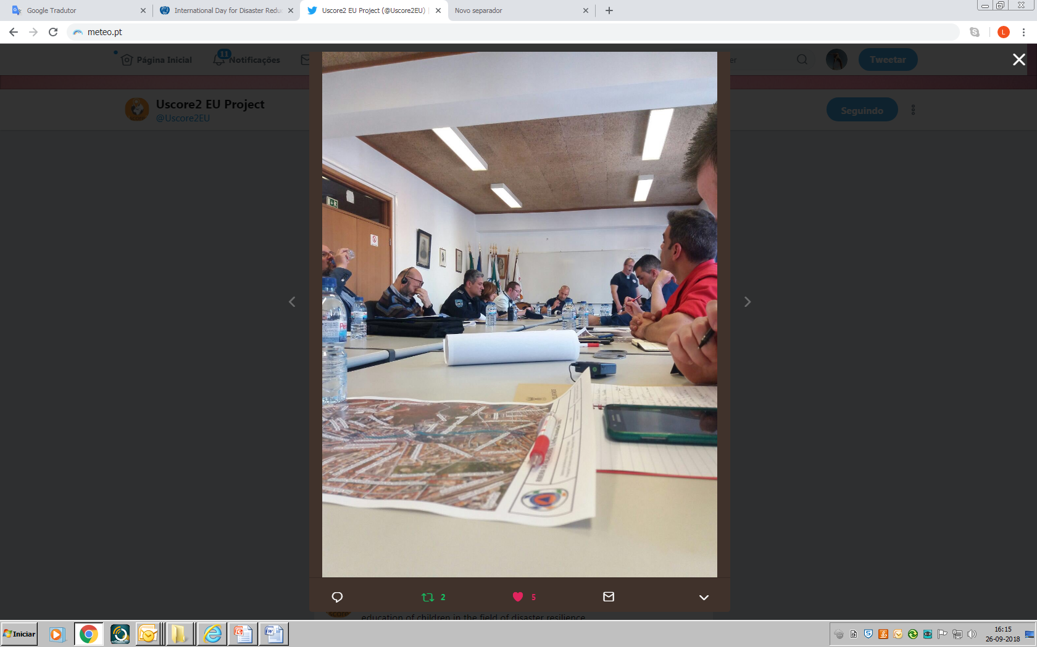
2. PEER REVIEW AMADORA 2.4. Benefits\impacts
POSITIVE (in all aspects!)
THE MAYOR'S LEADERSHIP WAS REINFORCED BY THE PEER REVIEW. MORE CONFIDENCE AND INTERNATIONAL RECOGNITION OF THE WORK SHE IS DOING;
INTERNAL/EXTERNAL (STAKEHOLDERS) DISCUSSION ABOUT THE PEER REVIEW RECOMMENDATIONS.
REFLECTION WAS MADE ABOUT RISK SCENARIOS IN THE CITY AND THE RESOURCES NEED FOR SPECIFIC OPERATIONS.
THE INTERACTIONS CREATED IN THE ISSUE OF COMMUNITY RESILIENCE IN ORDER TO UNDERSTAND WHAT KIND OF NETWORKS WERE ESTABLISH AND HOW SUCCESSFUL THEY ARE.
CONFIDENCE AND ASSURANCE TO DO MORE AND BETTER
Notes:
18

Slide 19
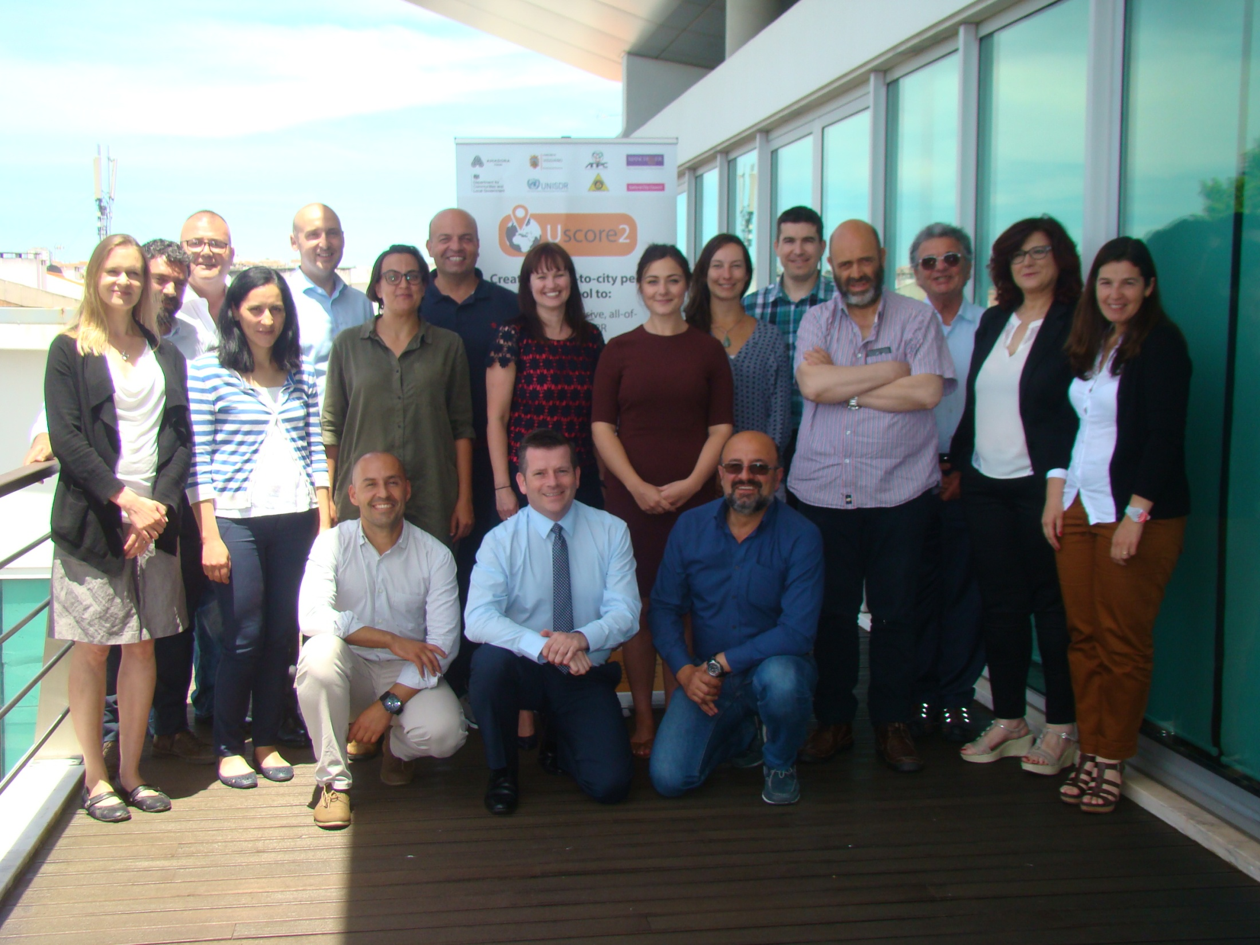
THANK YOU AND BE RESILIENT!

Slide 20
MASTERCLASS Case study of the use of module 6 in a peer review [Amadora] Luís Carvalho | Civil Protection Coordinator MUNICIPALITY OF AMADORA European Forum for Disaster Risk Reduction Rome | 21ST November 2018
Notes:
20

